Slide 1
Querying with Impala and Hive
Chapter 4

Slide 2
Querying with Hive and Impala
In this chapter, you will learn
How to explore databases and tables with HiveQL and Impala SQL
How HiveQL, Impala SQL, and SQL syntax compare
Which data types HiveQL and Impala SQL support

Slide 3
Chapter Topics
Querying with Impala and Hive
Databases and Tables
Basic Hive and Impala Query Language Syntax
Data Types
Differences Between Impala and Hive Query Syntax
Using Hue to Execute Queries
Using the Impala Shell
Using Beeline (Hive’s Shell)
Conclusion
Hands-On Exercise: Running Queries from the Shell, Scripts, and Hue

Slide 4
Tables
Data for Hive and Impala tables is stored on the filesystem (typically HDFS)
Each table maps to a single directory
A table’s directory may contain multiple files
Typically delimited text files, but many formats are supported
Subdirectories are not allowed
– Unless the table is partitioned (see later)
The Metastore gives context to this data
Helps map raw data in HDFS to named columns of specific types

Slide 5
Databases
Each table belongs to a specific database
Early versions of Hive supported only a single database
It placed all tables in the same database (named default)
This is still the default behavior
Hive supports multiple databases as of release 0.7.0
Helpful for organization and authorization

Slide 6


Exploring Databases and Tables (1)
Which databases are available?
SHOW DATABASES;
+----------------+
| database_name |
+----------------+
| sales |
| default |
+----------------+

Slide 7







Exploring Databases and Tables (2)
Impala and Hive both connect to the default database by default
Switch between databases with the USE command
$ impala-shell
> SELECT * FROM customers;
> USE sales;
Queries table in the
default database
> SELECT * FROM customers;
Queries table in the
sales database

Slide 8







Exploring Databases and Tables (2)
Use SHOW TABLES to list the tables in a database
Shows tables in the current database
SHOW TABLES IN sales;
+-----------+
| tab_name |
+-----------+
| customers |
| prospects |
+-----------+
USE accounting; SHOW TABLES;
+-----------+
| tab_name |
+-----------+
| invoices |
| taxes |
Shows tables in another database
+-----------+

Slide 9


Exploring Databases and Tables (3)
The DESCRIBE command displays basic structure for a table
> DESCRIBE orders;
+------------+-----------+---------+
| name | type | comment |
+------------+-----------+---------+
| order_id
| cust_id
|
| int
| int
|
|
|
|
|
order_date | timestamp |
+------------+-----------+---------+
Use DESCRIBE FORMATTED command for detailed info
– Input and output formats, file locations, etc.

Slide 10
Chapter Topics
Querying with Impala and Hive
Databases and Tables
Basic Hive and Impala Query Language Syntax
Data Types
Differences Between Impala and Hive Query Syntax
Using Hue to Execute Queries
Using the Impala Shell
Using Beeline (Hive’s Shell)
Conclusion
Hands-On Exercise: Running Queries from the Shell, Scripts, and Hue
04-10

Slide 11
An Introduction To HiveQL and Impala Query Language
HiveQL is Hive’s query language
Based on a subset of SQL-92, plus Hive-specific extensions
Impala Query Language is very similar to HiveQL
Lacks some features (will be noted during class)
Some limitations compared to ‘standard’ SQL
Some features are not supported
Others are only partially implemented

Slide 12



Syntax Basics
Keywords are not case-sensitive
Though they are often capitalized by convention
Statements are terminated by a semicolon
A statement may span multiple lines
Comments begin with -- (double hyphen)
Only supported in scripts
There are no multi-line comments
myscript.sql
SELECT cust_id, fname, lname FROM customers
WHERE zipcode='60601';
-- downtown Chicago

Slide 13


Selecting Data from Tables
The SELECT statement retrieves data from tables
– Can specify an ordered list of individual columns
SELECT cust_id, fname, lname FROM customers;
– An asterisk matches all columns in the table
SELECT * FROM customers;

Slide 14



Limiting and Sorting Query Results
The LIMIT clause sets the maximum number of rows returned
SELECT fname, lname FROM customers LIMIT 10;
Caution: no guarantee regarding which 10 results are returned
Use ORDER BY for top-N queries
The field(s) you ORDER BY must be SELECTed
SELECT cust_id, fname, lname FROM customers ORDER BY cust_id DESC LIMIT 10;

Slide 15





Using a WHERE Clause to Restrict Results
WHERE clauses restrict rows to those matching specified criteria
– String comparisons are case-sensitive
SELECT * FROM orders WHERE order_id=1287;
SELECT * FROM customers WHERE state IN ('CA', 'OR', 'WA', 'NV', 'AZ');
You can combine expressions using AND or OR
SELECT * FROM customers WHERE fname LIKE 'Ann%'
AND (city='Seattle' OR city='Portland');

Slide 16


Table Aliases
Table aliases can help simplify complex queries
SELECT o.order_date, c.fname, c.lname FROM customers c JOIN orders o
ON (c.cust_id = o.cust_id) WHERE c.zipcode='94306';
– Note: Using AS to specify table aliases is also supported starting with CDH 5.1

Slide 17

Combining Query Results with UNION ALL
Unifies output from SELECTs into a single result set
The name, order, and types of columns in each query must match
Only supports UNION ALL
SELECT cust_id, fname, lname FROM customers
WHERE state='NY' UNION ALL
SELECT cust_id, fname, lname FROM customers
WHERE zipcode LIKE '073%'
UNION ALL can also be used with subqueries

Slide 18

Subqueries
Subqueries are supported only in the FROM clause of the SELECT
statement
SELECT prod_id, brand, name FROM (SELECT *
FROM products
WHERE (price - cost) / price > 0.65 ORDER BY price DESC
LIMIT 10) high_profits WHERE price > 1000
ORDER BY brand, name;
Supports arbitrary levels of subqueries
Each subquery must be named (like high_profits above)
Correlated subqueries supported in Impala 2.0 and later

Slide 19
Chapter Topics
Querying with Impala and Hive
Databases and Tables
Basic Hive and Impala Query Language Syntax
Data Types
Differences Between Impala and Hive Query Syntax
Using Hue to Execute Queries
Using the Impala Shell
Using Beeline (Hive’s Shell)
Conclusion
Hands-On Exercise: Running Queries from the Shell, Scripts, and Hue

Slide 20


Data Types
Each column is associated with a data type
Hive and Impala support more than a dozen types
Most are similar to ones found in relational databases
Hive also supports three complex types (covered later)
Use the DESCRIBE command to see a table’s column types
DESCRIBE products;
+-------------+--------+---------+
| name | type | comment |
+-------------+--------+---------+
| prod_id
| brand
| name
| price
| cost
|
| int |
| string |
| string |
| int
| int
int
|
|
|
|
|
|
|
|
|
shipping_wt |
+-------------+--------+---------+
04-20

Slide 21
Integer Types
Integer types are appropriate for whole numbers
– Both positive and negative values allowed
Name | Description | Example Value
TINYINT | Range: -128 to 127 | 17
SMALLINT | Range: -32,768 to 32,767 | 5842
INT | Range: -2,147,483,648 to 2,147,483,647 | 84127213
BIGINT | Range: ~ -9.2 quintillion to ~ 9.2 quintillion | 632197432180964

Slide 22
Decimal Types
Decimal types are appropriate for floating point numbers
Both positive and negative values allowed
Use DECIMAL when exact values are required!
Name | Description | Example Value
FLOAT | Decimals | 3.14159
DOUBLE | Very precise decimals | 3.14159265358979323846
DECIMAL(p,s)* | Exact precision | 3.14 (p=3, s=2)
* Available in version CDH 5.1 and later

Slide 23
Character Types
Character Types
Name | Description | Example Value
STRING | Character sequence | Impala rules!
CHAR(n) * | Fixed length character sequence | Impala rules!nnn (n=15)
VARCHAR(n) * | Variable length character sequence (max length n) | Impala rul (n=10)
* Available in CDH 5.2 and later

Slide 24
Other Simple Types
Other types
Name | Description | Example Value
BOOLEAN | True or False | TRUE
TIMESTAMP | Instant in time | 2013-06-14 16:51:05
BINARY* (Hive Only) | Raw bytes | N/A
* Available in Hive 0.8 and later

Slide 25
Chapter Topics
Querying with Impala and Hive
Databases and Tables
Basic Hive and Impala Query Language Syntax
Data Types
Differences Between Impala and Hive Query Syntax
Using Hue to Execute Queries
Using the Impala Shell
Using Beeline (Hive’s Shell)
Conclusion
Hands-On Exercise: Running Queries from the Shell, Scripts, and Hue

Slide 26
Differences Between Impala and Hive Query Syntax
Hive and Impala Query languages are very similar but not identical
Some Hive features are not available in Impala
– These will be covered in a later chapter
There are also a few minor syntax differences

Slide 27


Impala Metadata Cache Invalidation
Changes made to tables outside Impala require cache invalidation
– For example, creating tables with Hive or importing data with Sqoop
INVALIDATE METADATA;
REFRESH tablename;
Details on Impala metadata caching and invalidation are covered in a later chapter

Slide 28

Selecting Data in Impala
Impala does not require a FROM clause
SELECT SQRT(64) AS square_root;

Slide 29








Data Type Conversion
Hive auto-converts a STRING column used in numeric context
SELECT zipcode FROM customers LIMIT 1; 60601
SELECT zipcode + 1.5 FROM customers LIMIT 1; 60602.5
Impala requires an explicit CAST operation for this
SELECT | zipcode + 1.5 FROM customers LIMIT 1;
ERROR: | AnalysisException: Arithmetic operation | ...
SELECT CAST(zipcode AS float) + 1.5 FROM customers LIMIT 1;
60602.5

Slide 30


Limiting and Sorting Query Results
In versions of Impala before CDH 5.2
– When using ORDER BY, the LIMIT clause was mandatory in Impala
SELECT cust_id, fname, lname FROM customers ORDER BY cust_id DESC LIMIT 10;
Only one DISTINCT clause was allowed per query in Impala
– Typical workaround is to use subselect and UNION
Both of these restrictions are not present in CDH 5.2 and later
04-30

Slide 31
Handling of NULL Values
Impala and Hive handle out-of-range values differently
Hive returns NULL
Impala returns the maximum value for that type

Slide 32
Chapter Topics
Querying with Impala and Hive
Databases and Tables
Basic Hive and Impala Query Language Syntax
Data Types
Differences Between Impala and Hive Query Syntax
Using Hue to Execute Queries
Using the Impala Shell
Using Beeline (Hive’s Shell)
Conclusion
Hands-On Exercise: Running Queries from the Shell, Scripts, and Hue

Slide 33
Interacting with Hive and Impala
Hive and Impala offer many interfaces for running queries
Hue Web UI
Hive Query Editor (also know as Beeswax)
Impala Query Editor
Metastore Manager
Command-line shell
Hive: Beeline
Impala: Impala shell
ODBC / JDBC

Slide 34

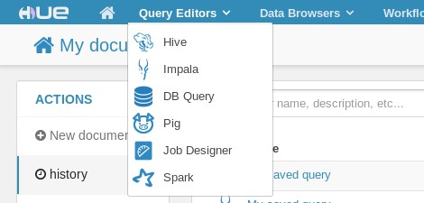





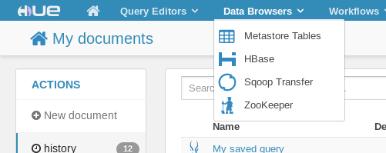


Using Hue with Hive and Impala
You can use Hue to…
Query data with Hive or Impala
View and manage the Metastore

Slide 35


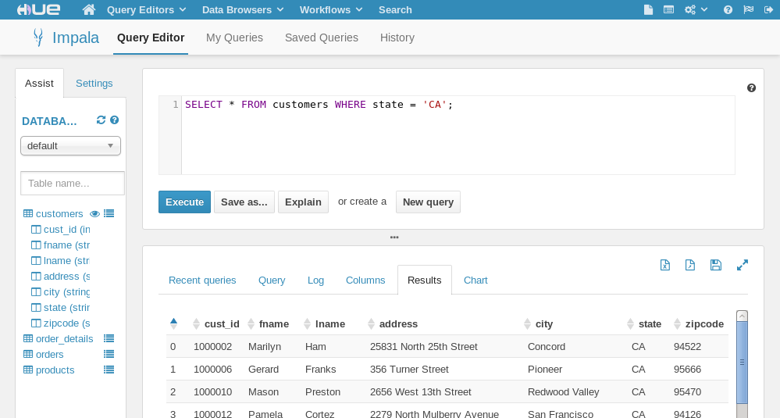











The Hue Query Editor
The Impala and Hive Query editors are nearly identical
Enter, edit, save and execute queries
Choose a database
Explore schema and sample data
View results, logs, reports, etc.

Slide 36
Chapter Topics
Querying with Impala and Hive
Databases and Tables
Basic Hive and Impala Query Language Syntax
Data Types
Differences Between Impala and Hive Query Syntax
Using Hue to Execute Queries
Using the Impala Shell
Using Beeline (Hive’s Shell)
Conclusion
Hands-On Exercise: Running Queries from the Shell, Scripts, and Hue

Slide 37




Starting the Impala Shell
You can execute statements in the Impala shell
This interactive tool is similar to the shell in MySQL
Execute the impala-shell command to start the shell
Some log messages truncated to better fit the slide
$ impala-shell
Connected to localhost.localdomain:21000 Server version: impalad version 1.4.0-cdh5 (…) Welcome to the Impala shell. [localhost.localdomain:21000] >
Use -i hostname:port option to connect to another server
$ impala-shell –i myserver.example.com:21000 [myserver.example.com:21000] >

Slide 38
Using the Impala Shell
Enter semicolon-terminated statements at the prompt
Hit [Enter] to execute a query or command
Use the quit command to exit the shell
Use impala-shell --help for a full list of options

Slide 39

Executing Queries in the Impala Shell
> SELECT lname,fname FROM customers WHERE state = 'CA' limit 50;
Query: select lname,fname FROM customers WHERE state = 'CA' limit 50
+------------+------------+
| lname | fname |
+------------+------------+
| Ham
| Franks
| Preston
| Cortez
…
|
| Marilyn
| Gerard
| Mason
| Pamela
|
|
|
|
Falgoust | Jennifer |
+------------+------------+
Returned 50 row(s) in 0.17s
>
Note: shell prompt abbreviated as >

Slide 40



Interacting with the Operating System
Use shell to execute system commands from within Impala shell
> shell date;
Mon May 20 16:44:35 PDT 2013
No direct support for HDFS commands
– But could run hdfs dfs using shell
> shell hdfs dfs -mkdir /reports/sales/2013;
04-40

Slide 41



Running Impala Queries from the Command Line
You can execute a file containing queries using the -f option
$ impala-shell -f myquery.hql
Run queries directly from the command line with the -q option
$ impala-shell -q 'SELECT * FROM users'
Use -o to capture output to file
– Optionally specify delimiter
$ impala-shell -f myquery.hql \
-o results.txt \
--output_file_field_delim='\t'

Slide 42
Chapter Topics
Querying with Impala and Hive
Databases and Tables
Basic Hive and Impala Query Language Syntax
Data Types
Differences Between Impala and Hive Query Syntax
Using Hue to Execute Queries
Using the Impala Shell
Using Beeline (Hive’s Shell)
Conclusion
Hands-On Exercise: Running Queries from the Shell, Scripts, and Hue

Slide 43

Starting Beeline (Hive’s Shell)
You can execute HiveQL statements in the Beeline shell
Interactive shell based on the SQLLine utility
Similar to the Impala shell
Start Beeline by specifying the URL for a Hive2 server
Plus username and password if required
$ beeline -u jdbc:hive2://host:10000 \
-n username -p password
0: jdbc:hive2://localhost:10000>

Slide 44


Executing Queries in Beeline
SQL commands are terminated with semi-colon (;)
Similar to Impala shell
– Results formatting is slightly different
1: url> SELECT lname,fname FROM customers
. . . > WHERE state = 'CA' LIMIT 50;
+-------------+-------------+
| lname | fname |
+-------------+-------------+
| Ham | Marilyn |
| Franks | Gerard |
| Preston | Mason |
...
| Falgoust | Jennifer |
+-------------+-------------+
50 rows selected (15.829 seconds)
1: url>

Slide 45

Using Beeline
Execute Beeline commands with ‘!’
No terminator character
Some commands
!connect url – connect to a different Hive2 server
!exit – exit the shell
!help – show the full list of commands
!verbose – show added details of queries
0: jdbc:hive2://localhost:10000> !exit

Slide 46

Executing Hive Queries from the Command Line
You can also execute a file containing HiveQL code using the -f option
$ beeline –u ... -f myquery.hql
Or use HiveQL directly from the command line using the -e option
$ beeline –u ... -e 'SELECT * FROM users'
Use the --silent
option to suppress informational messages
– Can also be used with -e or -f options
$ beeline –u ... --silent

Slide 47
Chapter Topics
Querying with Impala and Hive
Databases and Tables
Basic Hive and Impala Query Language Syntax
Data Types
Differences Between Impala and Hive Query Syntax
Using Hue to Execute Queries
Using the Impala Shell
Using Beeline (Hive’s Shell)
Conclusion
Hands-On Exercise: Running Queries from the Shell, Scripts, and Hue

Slide 48
Essential Points
HiveQL and Impala SQL syntax are familiar to those who know SQL
A subset of SQL-92, plus extensions
Every table belongs to exactly one database
The SHOW DATABASES command lists databases
The USE command switches the active database
The SHOW TABLES command lists all tables in a database
Every column in a table has an associated data type
Most simple column types are similar to SQL
Hive and Impala both have command line shells and Query Editors in Hue

Slide 49
Bibliography
The following offer more information on topics discussed in this chapter
HiveQL Language Manual on the Hive Wiki
http://tiny.cloudera.com/hqlmanual
Impala Documentation at Cloudera Web site
http://tiny.cloudera.com/cdh5impala
Beeline CLI reference
http://sqlline.sourceforge.net

Slide 50
Chapter Topics
Querying with Impala and Hive
Databases and Tables
Basic Hive and Impala Query Language Syntax
Data Types
Differences Between Impala and Hive Query Syntax
Using Hue to Execute Queries
Using the Impala Shell
Using Beeline (Hive’s Shell)
Conclusion
Hands-On Exercise: Running Queries from the Shell, Scripts, and Hue
04-50

Slide 51
Hands-on Exercise: Running Queries from the Shell, Scripts, and Hue
In this Hands-On Exercise, you will run queries from the Impala and Hive shells, scripts, and Hue
Please refer to the Hands-On Exercise Manual for instructions
04-51

Slide 52
Data Management
Chapter 5

Slide 53
Data Management
In this chapter you will learn
How Hive and Impala encode and store data
How to create databases, tables, and views
How to load data into tables
How to alter and remove tables
How to save query results into tables and files
05-2

Slide 54
Chapter Topics
Impala and Hive Data Management
Data Storage
Creating Databases and Tables
Loading Data
Altering Databases and Tables
Simplifying Queries with Views
Storing Query Results
Conclusion
Hands-On Exercise: Data Management

Slide 55










Recap: How Hive and Impala Load and Store Data
Hive and Impala use the metastore to determine data format and location
– The query itself operates on data stored in a filesystem (typically HDFS)
Metastore
(metadata in RDBMS)
Query
Impala or Hive Server
Tables
(data in HDFS files)

Slide 56









The Data Warehouse Directory
By default, data is stored in the HDFS directory
/user/hive/warehouse
Each table is a subdirectory containing any number of files
customers table
/user/hive/warehouse/customers
cust_id | name | country
001 | Alice | us
002 | Bob | ca
003 | Carlos | mx
… | … | …
392 | Maria | it
393 | Nigel | uk
394 | Ophelia | dk
… | … | …
a b | Alice Bob | us ca
c | Carlos | mx
d | Dieter | de
…
file1
m n | Maria Nigel | it uk
o | Ophelia | dk
p | Peter | us
…
file2

Slide 57


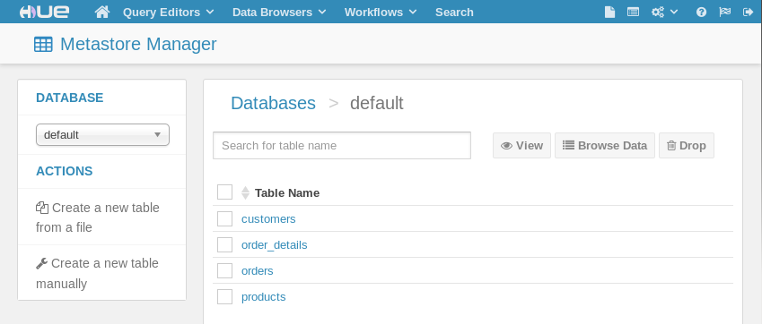
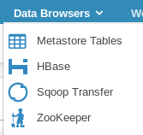


Using the Hue Metastore Manager
The Hue Metastore Manager
An alternative to using SQL commands to manage metadata
Allows you to create, load, preview, and delete databases and tables

Slide 58
Chapter Topics
Impala and Hive Data Management
Data Storage
Creating Databases and Tables
Loading Data
Altering Databases and Tables
Simplifying Queries with Views
Storing Query Results
Conclusion
Hands-On Exercise: Data Management

Slide 59

Creating a Database
Hive and Impala databases are simply namespaces
– Helps to organize your tables
To create a new database
CREATE DATABASE dualcore;
Adds the database definition to the metastore
Creates a storage directory in HDFS e.g./user/hive/warehouse/dualcore.db
To conditionally create a new database
– Avoids error in case database already exists (useful for scripting)
CREATE DATABASE IF NOT EXISTS dualcore;

Slide 60

Creating a Table (1)
Basic syntax for creating a table:
CREATE TABLE tablename (colname DATATYPE, ...) ROW FORMAT DELIMITED
FIELDS TERMINATED BY char
STORED AS {TEXTFILE|SEQUENCEFILE|…}
Creates a subdirectory in the database’s warehouse directory in HDFS
Default database:
/user/hive/warehouse/tablename
Named database:
/user/hive/warehouse/dbname.db/tablename

Slide 61


Creating a Table (2)
CREATE TABLE tablename (colname DATATYPE, ...) ROW FORMAT DELIMITED
FIE STO
LDS TERMINATED BY char
RED AS {TEXTFILE|SEQUENCEFILE|RCFILE|PARQUET}
Specify a name for the table, and list the column names and datatypes (see later)
05-10

Slide 62


Creating a Table (3)
CREATE TABLE tablename (colname DATATYPE, ...) ROW FORMAT DELIMITED
FIELDS TERMINATED BY char
STO
RED AS {TEXTFILE|SEQUENCEFILE|RCFILE|PARQUET}
This line states that fields in each file in the table’s
directory are delimited by some character. Hive’s default delimiter is Control-A, but you may specify an alternate delimiter...

Slide 63

Creating a Table (4)
CREATE TABLE tablename (colname DATATYPE, ...) ROW FORMAT DELIMITED
FIELDS TERMINATED BY char
STORED AS {TEXTFILE|SEQUENCEFILE|…}
…for example, tab-delimited data would require that
you specify FIELDS
TERMINATED BY '\t'

Slide 64


Creating a Table (5)
CREATE TABLE tablename (colname DATATYPE, ...) ROW FORMAT DELIMITED
FIELDS TERMINATED BY char
STORED AS {TEXTFILE|SEQUENCEFILE|…}
Finally, you may declare the file format. STORED AS TEXTFILE is the default and does not need to be specified

Slide 65


Example Table Definition
The following example creates a new table named jobs
– Data stored as text with four comma-separated fields per line
CREATE TABLE jobs (
id INT,
title STRING, salary INT, posted TIMESTAMP
)
ROW FORMAT DELIMITED FIELDS TERMINATED BY ',';
– Example of corresponding record for the table above
1,Data Analyst,100000,2013-06-21 15:52:03

Slide 66


Creating Tables Based On Existing Schema
Use LIKE to create a new table based on an existing table definition
CREATE TABLE jobs_archived LIKE jobs;
Column definitions and names are derived from the existing table
– New table will contain no data

Slide 67


Controlling Table Data Location
By default, table data is stored in the warehouse directory
This is not always ideal
– Data might be shared by several users
Use LOCATION to specify the directory where table data resides
CREATE TABLE jobs (
id INT, title STRING, salary INT,
posted TIMESTAMP
)
ROW FORMAT DELIMITED FIELDS TERMINATED BY ','
LOCATION '/dualcore/jobs';

Slide 68

Externally Managed Tables
CAUTION: Dropping a table removes its data in HDFS
Using EXTERNAL when creating the table avoids this behavior
– Dropping an external table removes only its metadata
CREATE EXTERNAL TABLE adclicks
( campaign_id STRING, click_time TIMESTAMP, keyword STRING,
site STRING, placement STRING, was_clicked BOOLEAN, cost SMALLINT)
LOCATION '/dualcore/ad_data';

Slide 69
Data formats
Avro
Uses JSON based schemas
Schema's sent during data exchange
Rich data structures.
A compact, fast, binary data format.
A container file, to store persistent data.
Simple integration with many languages. Code generation is not required to read or write data files nor to use or implement RPC protocols. Code generation as an optional optimization, only worth implementing for statically typed languages.
Avro API's exist for these languages Java, C, C++, C#, Python and Ruby.

Slide 70
Data formats
Avro
Avro relies on schemas for serialization/deserialization. When Avro data is stored in a file, its schema is stored with it, so that files may be processed later by any program. If the program reading the data expects a different schema, this can be easily resolved, since both schemas are present.

Slide 71
Data formats
Avro Supported data types:
Primitives:
null: no value
boolean: a binary value
int: 32-bit signed integer
long: 64-bit signed integer
float: single precision (32-bit) IEEE 754 floating-point number
double: double precision (64-bit) IEEE 754 floating-point number
bytes: sequence of 8-bit unsigned bytes
string: unicode character sequence

Slide 72
Data formats
Avro Supported data types:
Avro supports six kinds of complex types:
records,
enums,
arrays,
maps,
unions
Fixed
For example, 16-byte quantity may be declared with: {"type": "fixed", "size": 16, "name": "md5"}

Slide 73
Data formats
Parquet
Takes advantages of compressed, efficient columnar data representation available to any project in the Hadoop ecosystem, regardless of the choice of data processing framework, data model, or programming language.
Is built from the ground up with complex nested data structures in mind. We adopted the repetition/definition level approach to encoding such data structures, as described in Google’s Dremel paper; we have found this to be a very efficient method of encoding data in non-trivial object schemas.

Slide 74
Data formats
Parquet
Column data is of uniform type; therefore, there are some opportunities for storage size optimizations available in column-oriented data that are not available in row-oriented data. For example, many popular modern compression schemes, such as LZW or run-length encoding, make use of the similarity of adjacent data to compress. Missing values and repeated values, common in clinical data, can be represented by a two-bit marker.^{[6]} While the same techniques may be used on row-oriented data, a typical implementation will achieve less effective results.^{[7][8]}

Slide 75
Data formats
Avro vs Parquet
Avro (Writing)
Event data that can change over time
Sequence file – datasets shared between MR jobs
Text – adding large amount of data to HDFS quickly
Avro (Reading)
Latency increases as query conditions increase
Best for querying datasets that have changed over time
Parquet (Writing)
Slower (comparing to Avro) due to optimizations applied
Parquet (Reading)
Faster than Avro
Best for querying a few columns on a wide table

Slide 76

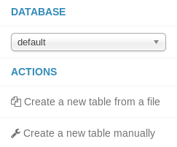

Creating Tables Using the Metastore Manager
The Metastore Manager provides a table creation wizard
Supports most but not all table options

Slide 77
Chapter Topics
Impala and Hive Data Management
Data Storage
Creating Databases and Tables
Loading Data
Altering Databases and Tables
Simplifying Queries with Views
Storing Query Results
Conclusion
Hands-On Exercise: Data Management

Slide 78
Data Validation
Impala and Hive are ‘schema on read’
Unlike an RDBMS, they do not validate data on insert
– Files are simply moved into place
Loading data into tables is therefore very fast
Errors in file format will be discovered when queries are performed
Missing or invalid data will be represented as NULL
05-20

Slide 79



Loading Data From HDFS Files
To load data, simply add files to the table’s directory in HDFS
Can be done directly using the hdfs dfs commands
This example loads data from HDFS into the sales table
$ hdfs dfs -mv sales.txt /user/hive/warehouse/sales/
Alternatively, use the LOAD DATA INPATH command
Done from within Hive or Impala
This moves data within HDFS, just like the command above
Source can be either a file or directory
LOAD DATA INPATH 'sales.txt' INTO TABLE sales;

Slide 80


Overwriting Data From Files
Add the OVERWRITE keyword to delete all records before import
Removes all files within the table’s directory
Then moves the new files into that directory
LOAD DATA INPATH 'sales.txt' OVERWRITE INTO TABLE sales;

Slide 81

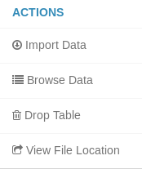


Loading Data Using the Metastore Manager
The Metastore Manager provides two ways to load data into a table
Table creation wizard
Import data wizard

Slide 82


Loading Data From a Relational Database
Sqoop has built-in support for importing data into Hive and Impala
Add the --hive-import option to your Sqoop command
Creates the table in the Hive metastore
Imports data from the RDBMS to the table’s directory in HDFS
$ sqoop import \
--connect jdbc:mysql://localhost/dualcore \
--username training \
--password training \
--fields-terminated-by '\t' \
--table employees \
--hive-import

Slide 83
Chapter Topics
Impala and Hive Data Management
Data Storage
Creating Databases and Tables
Loading Data
Altering Databases and Tables
Simplifying Queries with Views
Storing Query Results
Conclusion
Hands-On Exercise: Data Management

Slide 84





Removing a Database
Removing a database is similar to creating it
– Just replace CREATE with DROP
DROP DATABASE dualcore;
DROP DATABASE IF EXISTS dualcore;
These commands will fail if the database contains tables
In Hive: Add the CASCADE keyword to force removal
Caution: this command removes data in HDFS!
DROP DATABASE dualcore CASCADE;

Slide 85


Removing a Table
Table removal syntax is similar to database removal
DROP TABLE customers;
DROP TABLE IF EXISTS customers;
Regular (managed) tables
Metadata is removed
Data in HDFS is removed
Caution: No rollback or undo feature!
External tables
Metadata is removed
Data in HDFS is not removed

Slide 86






Renaming Tables and Columns
Use ALTER TABLE to modify a table’s metadata
– This command does not change the data in HDFS
Rename an existing table
ALTER TABLE customers RENAME TO clients;
Rename a column by specifying its old and new names
– Type must be specified even if it is unchanged
ALTER TABLE clients
CHANGE fname first_name STRING;
Old Name New Name Type

Slide 87




Modifyingand Adding Columns
You can also modify a column’s type
The old and new column names will be the same
You must ensure data in HDFS conforms to the new type
ALTER TABLE jobs CHANGE salary salary BIGINT;
Old Name New Name Type
Add new columns to a table
Appended to the end of any existing columns
Existing data will have NULL values for new columns
ALTER TABLE jobs
ADD COLUMNS (city STRING, bonus INT);

Slide 88






Reordering and Removing Columns
Use AFTER or FIRST to reorder columns
– Ensure that your data in HDFS matches the new order
ALTER TABLE jobs
CHANGE bonus bonus INT AFTER salary;
ALTER TABLE jobs
CHANGE bonus bonus INT FIRST;
Use REPLACE COLUMNS to change the entire table’s column definitions
– Any column not listed will be dropped from the metadata
ALTER TABLE jobs REPLACE COLUMNS (id INT,
title STRING, salary INT);
05-30

Slide 89
Chapter Topics
Impala and Hive Data Management
Data Storage
Creating Databases and Tables
Loading Data
Altering Databases and Tables
Simplifying Queries with Views
Storing Query Results
Conclusion
Hands-On Exercise: Data Management

Slide 90

Simplifying Complex Queries
Complex queries can become cumbersome
– Imagine typing this several times for different orders
SELECT o.order_id, order_date, p.prod_id, brand, name FROM orders o
JOIN order_details d
ON (o.order_id = d.order_id) JOIN products p
ON (d.prod_id = p.prod_id) WHERE o.order_id=6584288;

Slide 91

Creating Views
Views are conceptually like a table, but backed by a query
– You cannot directly add data to a view
CREATE VIEW order_info AS
SELECT o.order_id, order_date, p.prod_id, brand, name FROM orders o
JOIN order_details d
ON (o.order_id = d.order_id) JOIN products p
ON (d.prod_id = p.prod_id);
Our query is now greatly simplified
SELECT * FROM order_info WHERE order_id=6584288;

Slide 92



Inspecting and Removing Views
Use DESCRIBE FORMATTED to see the underlying query (Hive only)
DESCRIBE FORMATTED order_info;
Use DROP VIEW to remove a view
DROP VIEW order_info;

Slide 93
Chapter Topics
Impala and Hive Data Management
Data Storage
Creating Databases and Tables
Loading Data
Altering Databases and Tables
Simplifying Queries with Views
Storing Query Results
Conclusion
Hands-On Exercise: Data Management

Slide 94



Saving Query Output to a Table
SELECT statements display their results on screen
To save results to a table, use INSERT
Destination table must already exist
Existing contents will be deleted
OVERWRITE
TABLE
INSERT OVERWRITE TABLE ny_customers SELECT * FROM customers
WHERE state = 'NY';
INSERT INTO TABLE adds records without first deleting existing data
INSERT INTO TABLE ny_customers SELECT * FROM customers
WHERE state = 'NJ' OR state = 'CT';

Slide 95


Creating Tables Based On Existing Data
Create a table based on a SELECT statement
– Often know as ‘Create Table As Select’ (CTAS)
CREATE TABLE ny_customers AS SELECT cust_id, fname, lname FROM customers
WHERE state = 'NY';
Column definitions are derived from the existing table
Column names are inherited from the existing names
– Use aliases in the SELECT statement to specify new names

Slide 96


Writing Output To HDFS in Hive
Hive also lets you save output to a file in HDFS
INSERT OVERWRITE DIRECTORY '/dualcore/ny/’ SELECT * FROM customers
WHERE state = 'NY';
Produces text files delimited by Ctrl-A characters
– Workaround: Create an external table with delimiters of your choices, save the results to the table, then delete the table

Slide 97



Saving to Multiple Directories in Hive (1)
We just saw that you can save output to an HDFS file
INSERT OVERWRITE DIRECTORY 'ny_customers' SELECT cust_id, fname, lname
FROM customers WHERE state = 'NY';
This query could also be written as follows
FROM customers c
INSERT OVERWRITE DIRECTORY 'ny_customers' SELECT cust_id, fname, lname WHERE state='NY';

Slide 98


Saving to Multiple Directories in Hive (2)
We sometimes need to extract data to multiple files
Hive SELECT queries can take a long time to complete
Hive allows us to do this with a single query
Much more efficient than using multiple queries
Result is two directories in HDFS
FROM customers c
INSERT OVERWRITE DIRECTORY 'ny_names'
SELECT fname, lname WHERE state = 'NY'
INSERT OVERWRITE DIRECTORY 'ny_count'
SELECT count(DISTINCT cust_id) WHERE state = 'NY';
05-40

Slide 99

Saving to Multiple Directories in Hive (3)
The following query produces the same result
FROM (SELECT * FROM customers WHERE state='NY') nycust INSERT OVERWRITE DIRECTORY 'ny_names'
SELECT fname, lname
INSERT OVERWRITE DIRECTORY 'ny_count'
SELECT count(DISTINCT cust_id);

Slide 100
Chapter Topics
Impala and Hive Data Management
Data Storage
Creating Databases and Tables
Loading Data
Altering Databases and Tables
Simplifying Queries with Views
Storing Query Results
Conclusion
Hands-On Exercise: Data Management

Slide 101
Essential Points
Each table maps to a directory in HDFS
Table data is stored as one or more files
Default format: plain text with delimited fields
The Hue Metastore Manager can create and load simple tables
Dropping managed tables deletes data in HDFS
External tables require manualdata deletion
ALTER TABLE is used to add, modify, and remove columns
Views can help to simplify complex and repetitive queries

Slide 102
Chapter Topics
Impala and Hive Data Management
Data Storage
Creating Databases and Tables
Loading Data
Altering Databases and Tables
Simplifying Queries with Views
Storing Query Results
Conclusion
Hands-On Exercise: Data Management

Slide 103
Hands-On Exercise: Data Management
In this Hands-On Exercise, you will create and load tables using the Hue Metastore Manager, Impala SQL, and Sqoop
Please refer to the Hands-On Exercise Manual for instructions

